Slide 1
Information Retrieval and Web Search
Vasile Rus, PhD
vrus@memphis.edu
www.cs.memphis.edu/~vrus/teaching/ir-websearch/

Slide 2
Outline
Evaluation in Information Retrieval

Slide 3
Why System Evaluation?
There are many retrieval models/ algorithms/ systems, which one is the best?
What is the best component for:
  Ranking function (dot-product, cosine, …)
  Term selection (stopword removal, stemming…)
  Term weighting (TF, TF-IDF,…)
How far down the ranked list will a user need to look to find some/all relevant documents?

Slide 4
Difficulties in Evaluating IR Systems
Effectiveness is related to the relevancy of retrieved items
Relevancy is not typically binary but continuous
Even if relevancy is binary, it can be a difficult judgment to make
Relevancy, from a human standpoint, is:
  Subjective: Depends upon a specific user’s judgment
  Situational: Relates to user’s current needs
  Cognitive: Depends on human perception and behavior
  Dynamic: Changes over time

Slide 5
Real-life vs Laboratory
Real-life
  Interactive
  User characteristics such as user effort, user interface, duration
Laboratory
  Dominant method for evaluation
  Repeatability
  Scalability

Slide 6
Human Labeled Corpora
(Gold Standard)
Start with a corpus of documents
Collect a set of queries for this corpus
Have one or more human experts exhaustively label the relevant documents for each query
Typically assumes binary relevance judgments
Requires considerable human effort for large document/query corpora

Slide 7
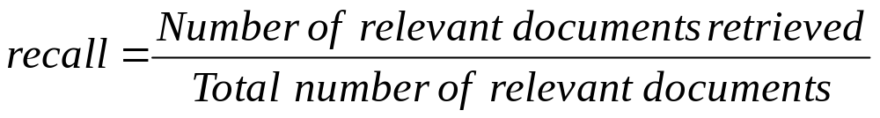
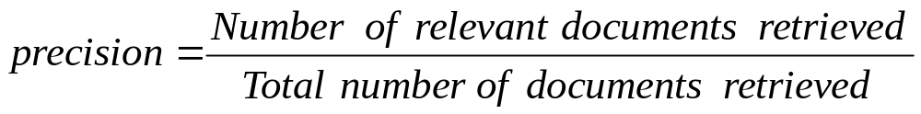
Precision and Recall
retrieved & irrelevant
Not retrieved & irrelevant
Entire document collection
irrelevant
Relevant documents
Retrieved documents
retrieved & relevant
not retrieved but relevant
relevant
retrieved
not retrieved

Slide 8
Precision and Recall
Precision
  The ability to retrieve top-ranked documents that are mostly relevant.
Recall
  The ability of the search to find all of the relevant items in the corpus.

Slide 9
Determining Recall is Difficult
Total number of relevant items is sometimes not available:
  Sample across the database and perform relevance judgment on these items
  Apply different retrieval algorithms to the same database for the same query; the aggregate of relevant items is taken as the total relevant set

Slide 10
Trade-off between Recall and Precision
Returns relevant documents but
misses many useful ones too
The ideal
1
Precision
0
1
Recall
Returns most relevant
documents but includes
lots of junk

Slide 11
Computing Recall/Precision Points
For a given query, produce the ranked list of retrievals
Adjusting a threshold on this ranked list produces different sets of retrieved documents, and therefore different recall/precision measures
Mark each document in the ranked list that is relevant according to the gold standard
Compute a recall/precision pair for each position in the ranked list that contains a relevant document

Slide 12
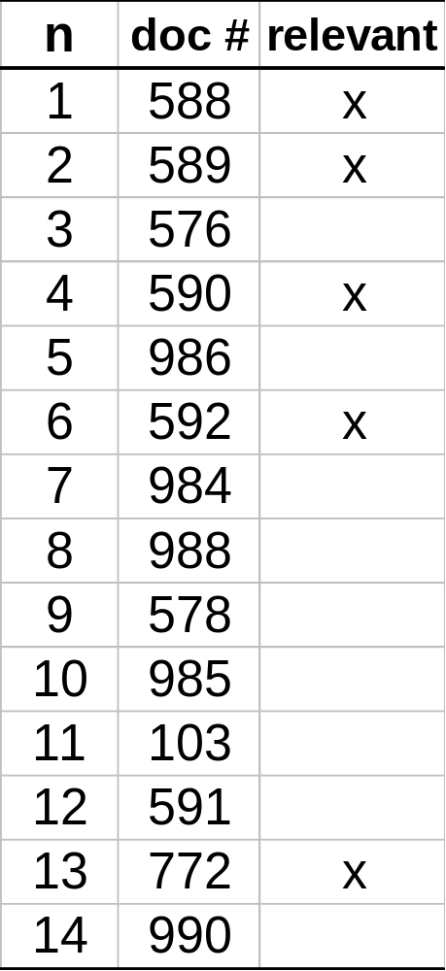
Recall/Precision Points: An Example
Let total # of relevant docs = 6
Check each new recall point:
R=1/6=0.167; P=1/1=1
R=2/6=0.333; P=2/2=1
R=3/6=0.5; P=3/4=0.75
R=4/6=0.667; P=4/6=0.667
Missing one
relevant document.
Never reach
100% recall
R=5/6=0.833; p=5/13=0.38

Slide 13
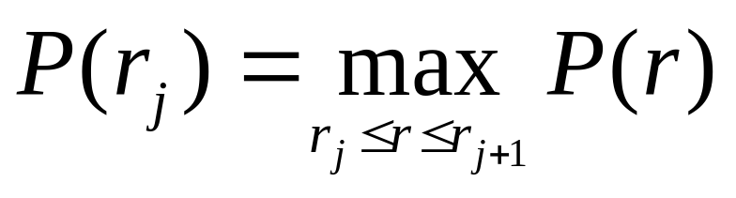
Interpolating a Recall/Precision Curve
Interpolate a precision value for each standard recall level:
  r_{j} ∈{0.0, 0.1, 0.2, 0.3, 0.4, 0.5, 0.6, 0.7, 0.8, 0.9, 1.0}
  r₀ = 0.0, r₁ = 0.1, …, r₁₀=1.0
The interpolated precision at the j-th standard recall level is the maximum known precision at any recall level between the j-th and (j + 1)-th level:

Slide 14
Interpolating a Recall/Precision Curve
Precision
1.0
0.8
0.6
0.4
0.2
Recall
0.2
0.4
0.6
0.8
1.0

Slide 15
Average Recall/Precision Curve
Typically average performance over a large set of queries
Compute average precision at each standard recall level across all queries
Plot average precision/recall curves to evaluate overall system performance on a document/query corpus

Slide 16
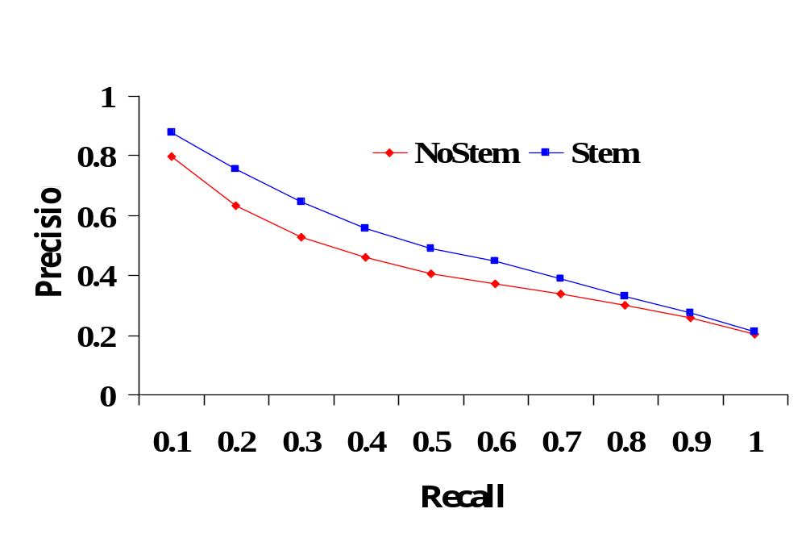
Compare Two or More Systems
The curve closest to the upper right-hand corner of the graph indicates the best performance

Slide 17
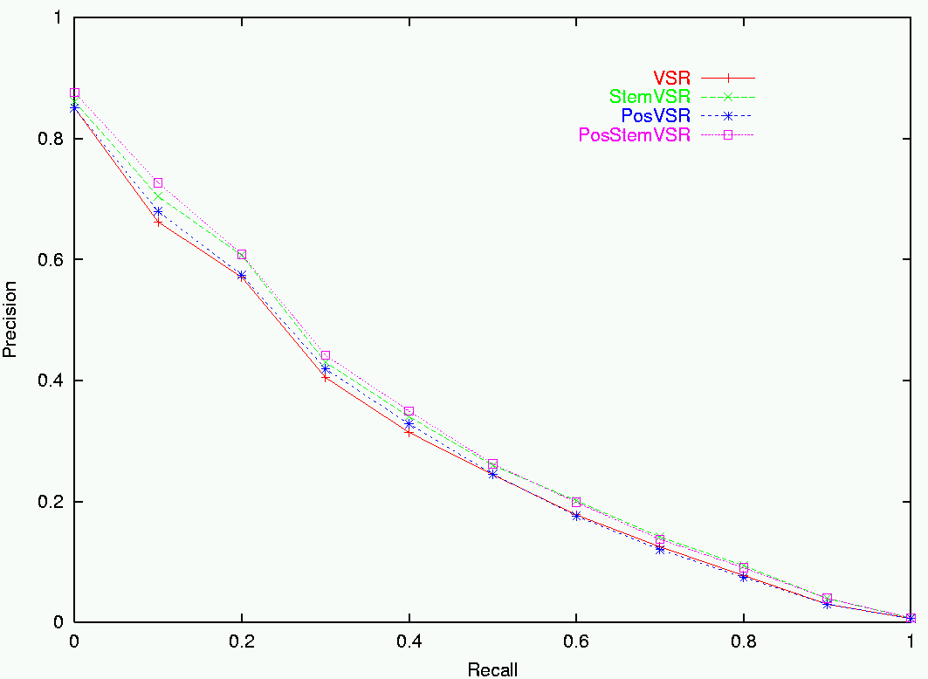
Sample RP Curve for CF Corpus

Slide 18
Average Precision
A single value summary of the ranking by averaging the precision figures obtained after each new relevant document is observed
Avg-P = (1+1+0.75+0.667+0.38)/5=0.759

Slide 19
R- Precision
Precision at the R-th position in the ranking of results for a query that has R relevant documents
R = # of relevant docs = 6
R-Precision = 4/6 = 0.67

Slide 20
Precision and Recall Cons
Recall is hard to estimate for large collections, e.g. Web
A single measure can be more appropriate
Interactivity is key with modern retrieval tasks
  Informativeness of the retrieval process is more appropriate
Recall and Precision are not appropriate for weak ordering scheme

Slide 21
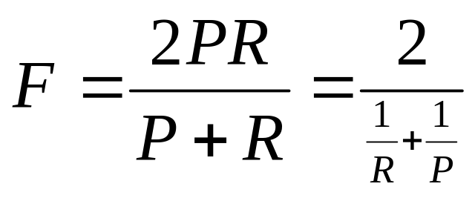
F-Measure
One measure of performance that takes into account both recall and precision
Harmonic mean of recall and precision:
Compared to arithmetic mean, both need to be high for harmonic mean to be high

Slide 22
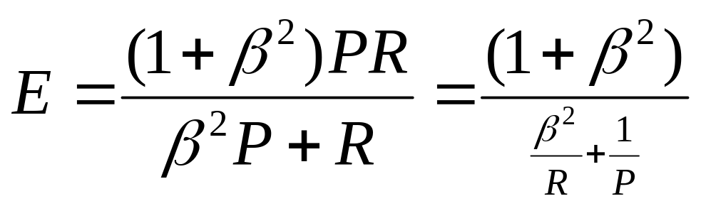
E-Measure (parameterized F-Measure)
A variant of F measure that allows weighting emphasis on precision over recall:
Value of β controls trade-off:
  β = 1: Equally weight precision and recall (E=F)
  β > 1: Weight precision more
  β < 1: Weight recall more

Slide 23
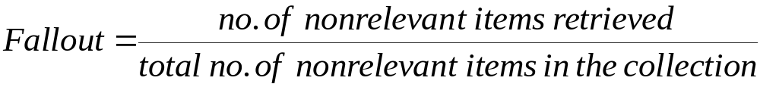
Fallout Rate
Problems with both precision and recall:
  Number of irrelevant documents in the collection is not taken into account
  Recall is undefined when there is no relevant document in the collection
  Precision is undefined when no document is retrieved

Slide 24
Subjective Relevance Measure
Novelty Ratio: The proportion of items retrieved and judged relevant by the user and of which they were previously unaware
  Ability to find new information on a topic
Coverage Ratio: The proportion of relevant items retrieved out of the total relevant documents known to a user prior to the search
  Relevant when the user wants to locate documents which they have seen before (e.g., the budget report for Year 2000)

Slide 25
Other Factors to Consider
User effort: Work required from the user in formulating queries, conducting the search, and screening the output
Response time: Time interval between receipt of a user query and the presentation of system responses
Form of presentation: Influence of search output format on the user’s ability to utilize the retrieved materials
Collection coverage: Extent to which any/all relevant items are included in the document corpus

Slide 26
Experimental Setup for Benchmarking
Analytical performance evaluation is difficult for document retrieval systems because many characteristics such as relevance, distribution of words, etc., are difficult to describe with mathematical precision
Performance is measured by benchmarking; that is, the retrieval effectiveness of a system is evaluated on a given set of documents, queries, and relevance judgments
Performance data is valid only for the environment under which the system is evaluated

Slide 27
Benchmarks
A benchmark collection contains:
  A set of standard documents and queries/topics
  A list of relevant documents for each query
Standard collections for traditional IR:
  Smart collection: ftp://ftp.cs.cornell.edu/pub/smart
  TREC: http://trec.nist.gov/
Retrieved result
Precision and Recall
Standard document collection
Algorithm under test
Evaluation
Standard queries
Standard result

Slide 28
Benchmarking − The Problems
Performance data is valid only for a particular benchmark
Building a benchmark corpus is a difficult task
Benchmark web corpora are just starting to be developed
Benchmark foreign-language corpora are just starting to be developed

Slide 29
Early Test Collections
Previous experiments were based on the SMART collection which is fairly small (ftp://ftp.cs.cornell.edu/pub/smart)
Collection Number Of Number Of Raw Size
Name Documents Queries (Mbytes)
CACM 3,200 64 1.5
CISI 1,460 111 1.3
CRAN 1,400 225 1.6
MED 1,033 30 1.1
TIME 423 83 1.5
Different researchers used different test collections and evaluation techniques

Slide 30
The TREC Benchmark
TREC: Text REtrieval Conference (http://trec.nist.gov/)
Originated from the TIPSTER program sponsored by
Defense Advanced Research Projects Agency (DARPA)
Became an annual conference in 1992, co-sponsored by the
National Institute of Standards and Technology (NIST) and
DARPA
Participants are given parts of a standard set of documents
and TOPICS (from which queries have to be derived) in
different stages for training and testing
Participants submit the P/R values for the final document
and query corpus and present their results at the conference

Slide 31
The TREC Objectives
Provide a common ground for comparing different IR
techniques.
  Same set of documents and queries, and same evaluation method
Sharing of resources and experiences in developing the
benchmark
  With major sponsorship from government to develop large benchmark collections
Encourage participation from industry and academia
Development of new evaluation techniques, particularly for
new applications
  Retrieval, routing/filtering, non-English collection, web-based collection, question answering

Slide 32
TREC Advantages
Large scale (compared to a few MB in the SMART or other collections)
Relevance judgments provided
Under continuous development with support from the U.S. Government
Wide participation:
  TREC 1: 28 papers 360 pages
  TREC 4: 37 papers 560 pages
  TREC 7: 61 papers 600 pages
  TREC 8: 74 papers

Slide 33
TREC Tasks
Ad hoc: New questions are being asked on a static set of data
Routing: Same questions are being asked, but new information is being searched. (news clipping, library profiling)
New tasks added after TREC 5 - Interactive, multilingual, natural language, multiple database merging, filtering, very large corpus (20 GB, 7.5 million documents), question answering

Slide 34
Characteristics of the TREC Collection
Both long and short documents (from a few hundred to over one thousand unique terms in a document)
Test documents consist of:
WSJ Wall Street Journal articles (1986-1992) 550 M
AP Associate Press Newswire (1989) 514 M
ZIFF Computer Select Disks (Ziff-Davis Publishing) 493 M
FR Federal Register 469 M
DOE Abstracts from Department of Energy reports 190 M

Slide 35
More Details on Document Collections
Volume 1 (Mar 1994) - Wall Street Journal (1987, 1988, 1989), Federal Register (1989), Associated Press (1989), Department of Energy abstracts, and Information from the Computer Select disks (1989, 1990)
Volume 2 (Mar 1994) - Wall Street Journal (1990, 1991, 1992), the Federal Register (1988), Associated Press (1988) and Information from the Computer Select disks (1989, 1990)
Volume 3 (Mar 1994) - San Jose Mercury News (1991), the Associated Press (1990), U.S. Patents (1983-1991), and Information from the Computer Select disks (1991, 1992)
Volume 4 (May 1996) - Financial Times Limited (1991, 1992, 1993, 1994), the Congressional Record of the 103rd Congress (1993), and the Federal Register (1994).
Volume 5 (Apr 1997) - Foreign Broadcast Information Service (1996) and the Los Angeles Times (1989, 1990).

Slide 36
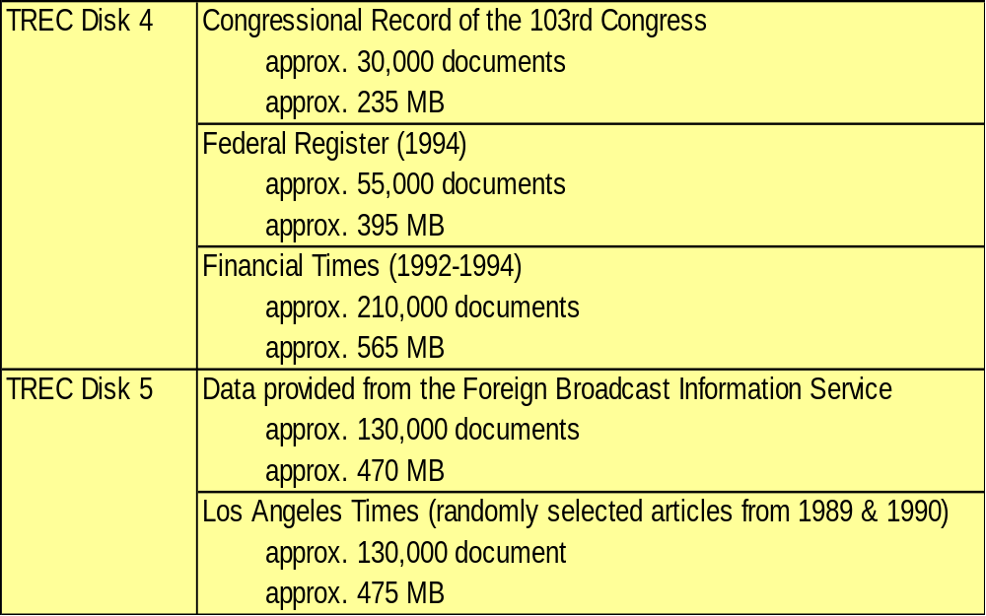
TREC Disk 4,5

Slide 37
Sample Document (with SGML)
<DOC>
<DOCNO> WSJ870324-0001 </DOCNO>
<HL> John Blair Is Near Accord To Sell Unit, Sources Say </HL>
<DD> 03/24/87</DD>
<SO> WALL STREET JOURNAL (J) </SO>
<IN> REL TENDER OFFERS, MERGERS, ACQUISITIONS (TNM) MARKETING, ADVERTISING (MKT) TELECOMMUNICATIONS, BROADCASTING, TELEPHONE, TELEGRAPH (TEL) </IN>
<DATELINE> NEW YORK </DATELINE>
<TEXT>
John Blair &amp; Co. is close to an agreement to sell its TV station advertising representation operation and program production unit to an investor group led by James H. Rosenfield, a former CBS Inc. executive, industry sources said. Industry sources put the value of the proposed acquisition at more than $100 million. ...
</TEXT>
</DOC>

Slide 38
Sample Query (with SGML)
<top>
<head> Tipster Topic Description
<num> Number: 066
<dom> Domain: Science and Technology
<title> Topic: Natural Language Processing
<desc> Description: Document will identify a type of natural language processing technology which is being developed or marketed in the U.S.
<narr> Narrative: A relevant document will identify a company or institution developing or marketing a natural language processing technology, identify the technology, and identify one of more features of the company's product.
<con> Concept(s): 1. natural language processing ;2. translation, language, dictionary
<fac> Factor(s):
<nat> Nationality: U.S.</nat>
</fac>
<def> Definitions(s):
</top>

Slide 39
TREC Properties
Both documents and queries contain many different kinds of information (fields)
Generation of the formal queries (Boolean, Vector Space, etc.) is the responsibility of the system
  A system may be very good at querying and ranking, but if it generates poor queries from the topic, its final P/R would be poor

Slide 40
Evaluation
Summary table statistics: Number of topics, number of documents retrieved, number of relevant documents
Recall-precision average: Average precision at 11 recall levels (0 to 1 at 0.1 increments)
Document level average: Average precision when 5, 10, .., 100, … 1000 documents are retrieved
Average precision histogram: Difference of the R-precision for each topic and the average R-precision of all systems for that topic

Slide 41
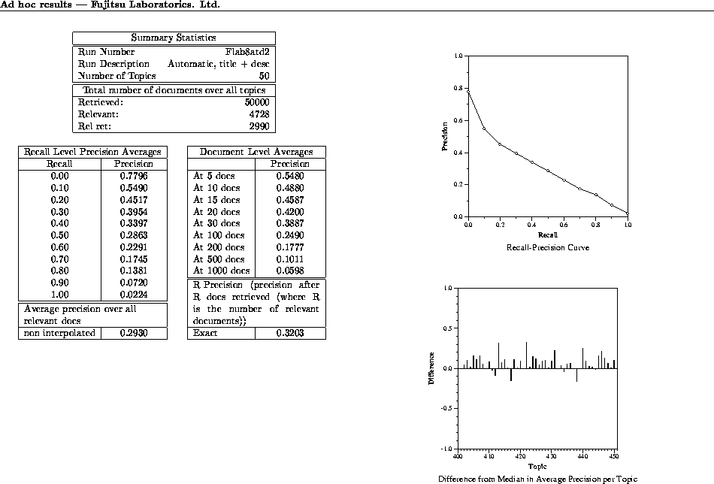

Slide 42
Cystic Fibrosis (CF) Collection
1,239 abstracts of medical journal articles on CF
100 information requests (queries) in the form of complete English questions
Relevant documents determined and rated by 4 separate medical experts on 0-2 scale:
  0: Not relevant
  1: Marginally relevant
  2: Highly relevant

Slide 43
CF Document Fields
MEDLINE access number
Author
Title
Source
Major subjects
Minor subjects
Abstract (or extract)
References to other documents
Citations to this document

Slide 44
Sample CF Document
AN 74154352
AU Burnell-R-H. Robertson-E-F.
TI Cystic fibrosis in a patient with Kartagener syndrome.
SO Am-J-Dis-Child. 1974 May. 127(5). P 746-7.
MJ CYSTIC-FIBROSIS: co. KARTAGENER-TRIAD: co.
MN CASE-REPORT. CHLORIDES: an. HUMAN. INFANT. LUNG: ra. MALE.
SITUS-INVERSUS: co, ra. SODIUM: an. SWEAT: an.
AB A patient exhibited the features of both Kartagener syndrome and
cystic fibrosis. At most, to the authors' knowledge, this
represents the third such report of the combination. Cystic
fibrosis should be excluded before a diagnosis of Kartagener
syndrome is made.
RF 001 KARTAGENER M BEITR KLIN TUBERK 83 489 933
002 SCHWARZ V ARCH DIS CHILD 43 695 968
003 MACE JW CLIN PEDIATR 10 285 971
…
CT 1 BOCHKOVA DN GENETIKA (SOVIET GENETICS) 11 154 975
2 WOOD RE AM REV RESPIR DIS 113 833 976
3 MOSSBERG B MT SINAI J MED 44 837 977
…

Slide 45
Sample CF Queries
QN 00002
QU Can one distinguish between the effects of mucus hypersecretion and
infection on the submucosal glands of the respiratory tract in CF?
NR 00007
RD 169 1000 434 1001 454 0100 498 1000 499 1000 592 0002 875 1011
QN 00004
QU What is the lipid composition of CF respiratory secretions?
NR 00009
RD 503 0001 538 0100 539 0100 540 0100 553 0001 604 2222 669 1010
711 2122 876 2222
NR: Number of Relevant documents
RD: Relevant Documents
Ratings code: Four 0-2 ratings, one from each expert

Slide 46
Summary
Evaluation in IR

Slide 47
Next
Query Languages

